Slide 1

CSE 464 : Software Quality Assurance and Testing
Structural (code-based) Based Testing II
Janaka Balasooriya

Slide 2
From the Last Lecture
Code based testing focus more on the statements, logic paths, and data in a program under test and test cases are directly based on testing the correctness of them.
Code Based Testing Strategies:
Basic path testing (Control flow coverage)
Statement coverage
Decision-to-Decision testing
Dataflow coverage
Condition testing
Code based risk assessments (complexity of the code, object oriented matrices …etc)
Most of these testing techniques see the program as a graph.

Slide 3
Program Graphs of Structured Programming Constructs
Develop graph structures for following fundamental constructs
Sequence
Pre-test Loop
Post-test Loop
If-Then
If-Then-Else
Switch-Case

Slide 4
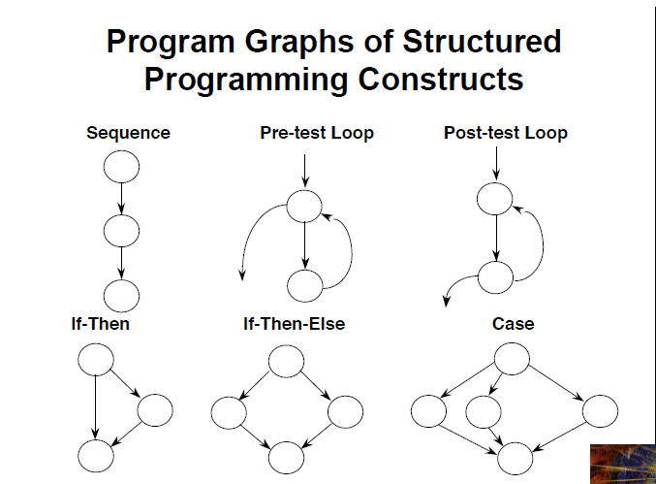

Slide 5
Control Flow Graph Example : The if, and if-else Statements
if (x < y)
{
y = 0;
x = x + 1;
}
1
x < y
y = 0
x = x + 1
2
x >= y
3
Introduction to Software Testing (Ch 2) © Ammann & Offutt
if (x < y)
{
y = 0;
x = x + 1;
}
else
{
x = y;
}
1
x < y
x >= y
y = 0
x = x + 1
2
3
x = y
4

Slide 6
Control Flow Graph Example : while and for Loops
x = 0;
while (x < y)
{
y = f (x, y);
x = x + 1;
}
x = 0
1
decision node
2
x < y
x >= y
implicitly initializes loop
x = 0
1
3
4
y =f(x,y)
x = x + 1
2
x < y
x >= y
for (x = 0; x < y; x++)
{
y = f (x, y);
}
y = f (x, y)
3
5
4
x = x + 1
Introduction to Software Testing (Ch 2) © Ammann & Offutt
implicitly increments loop

Slide 7
Activity : do Loop, break and continue
x = 0;
while (x < y)
{
y = f (x, y);
if (y == 0)
{
break;
} else if y < 0)
{
y = y*2;
continue;
}
x = x + 1;
}
print (y);
x = 0;
do
{
y = f (x, y);
x = x + 1;
} while (x < y);
println (y)
Introduction to Software Testing (Ch 2) © Ammann & Offutt

Slide 8
Control Flow Graph Example : The case (switch) Structure
read ( c) ;
switch ( c )
{
case ‘N’:
y = 25;
break;
case ‘Y’:
y = 50;
break;
default:
y = 0;
break;
}
print (y);
1
read ( c );
c == ‘N’
c == ‘Y’
default
2
3
4
y = 25;
break;
y = 0;
break;
y = 50;
break;
5
print (y);
Introduction to Software Testing (Ch 2) © Ammann & Offutt

Slide 9
Class Activity
Draw the control flow graph of the loan calculation problem discussed in the class
Then identify all the independent paths
Develop test cases and write Junit program to test the application

Slide 10
Class Activity
Draw the control flow graph of the triangle problem discussed in the class
Then identify all the independent paths

Slide 11
Basic Path Testing : CountC function Example
private static int CountC(String myString)
{
int index =0, i=0, j=0, k=0;
char A='A', B='B', C='C';
if(myString.charAt(index) == A)
{
while(++index < myString.length())
{
if(myString.charAt(index) == B)
{
j=j+1;
}else if(myString.charAt(index) == C)
{
i += j;
k += 1;
j=0;
}
}
i=i+j;
}
return i;
}
Draw the flow graph
Identify all independent paths
Design test cases
Write a Junit code to test the correctness of the code. Objective of the program is to count number of C’s on a string if the string start with A and has C’s followed by
Notes:
11

Slide 12
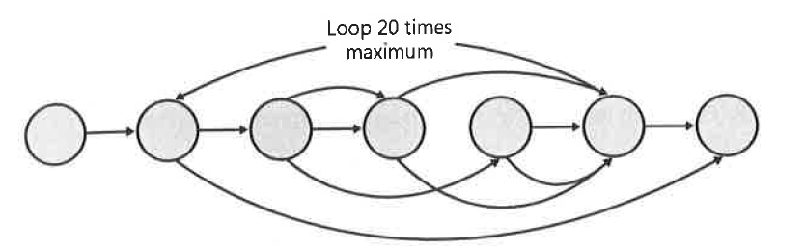
How many Independent Paths Here?

